Slide 1
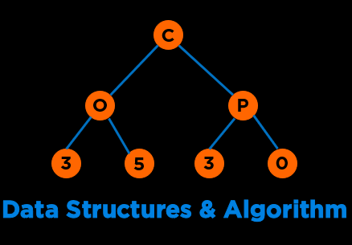
Graphs
Notes:
Hi everyone, welcome to the second module of the course

Slide 2
Categories of Data Structures
Linear Ordered
Non-linear Ordered
Not Ordered
Lists
Trees
Sets
Stacks
Graphs
Tables/Maps
Queues
Notes:
Data structures are ways to collect data. There are basic categories of data structures:

Slide 3
Recap
Non-linear Ordered
Graphs
4.1.1
Graph Implementations
Edge List
Adjacency Matrix
Adjacency List
Graph Traversals
BFS
DFS
Notes:
Discussed, touched upon, went over, covered
Emerges out of the limitations offered by our second approach

Slide 4
BFS vs DFS
01 02 03 04 05 06 07 08 09 10 11 12 13 14 15 16 17 18 19 20 21 22 23
string source = "A"; std::set<string> visited; std::queue<string> q; visited.insert(source); q.push(source); cout<<"BFS: "; while(!q.empty()) { string u = q.front(); cout<<u; q.pop(); vector<string> neighbors = graph[u]; for(string v: neighbors) { if(visited.count(v)==0) { visited.insert(v); q.push(v); } } }
01 02 03 04 05 06 07 08 09 10 11 12 13 14 15 16 17 18 19 20 21 22 23
string source = "A"; std::set<string> visited; std::stack<string> s; visited.insert(source); s.push(source); cout<<“DFS: "; while(!s.empty()) { string u = s.top(); cout<<u; s.pop(); vector<string> neighbors = graph[u]; for(string v: neighbors) { if(visited.count(v)==0) { visited.insert(v); s.push(v); } } }
Theoretical Complexity: O(V+E)
Notes:
For any possible way of organizing data, we must think about cost;
minimize time cost of most frequent operations;
Lets say we have a social network, we might need to find If a is friends with B

Slide 5
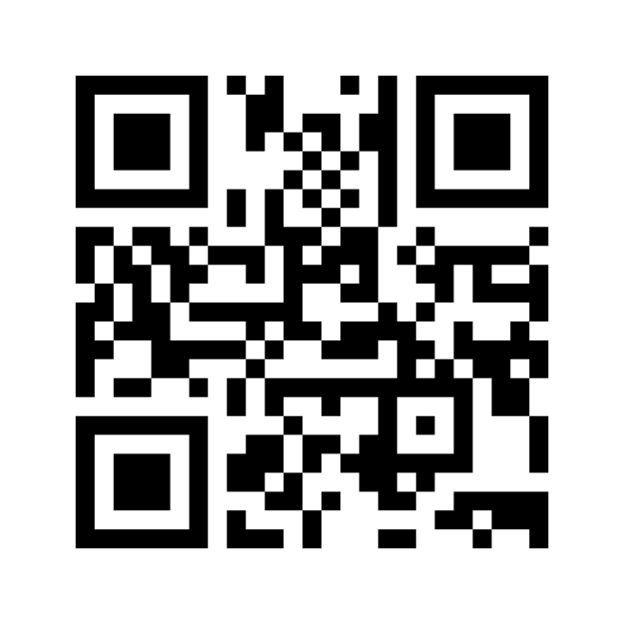
Mentimeter
Menti.com
8880 8243
Notes:
Array of Strings

Slide 6
Mentimeter
10
B
E
4
8
7
6
A
9
D
5
G
2
9
8
2
C
F
1
Notes:
Array of Strings

Slide 7
s-t Path
Is there a path between vertices s and t?
D
B
F
Is there a path between vertices A and C? - Yes
Is there a path between vertices A and Q? - No
Solution
Perform DFS or BFS with source “s” and if we encounter “t” in the path/traversal, then return True otherwise False
A
E
C
Q
Notes:
In the last lecture we covered BFS and DFS and today we will continue with some applications of these traversals in common problem.

Slide 8
7.2.1 DFS to Find Whether a Given Vertex is Reachable (Iterative)
bool dfs(const Graph& graph, int src, int dest)
{
set<int> visited;
stack<int> s;
visited.insert(src);
s.push(src);
while(!s.empty())
{
int u = s.top();
s.pop();
for(auto v: graph.adjList[u])
{
if(v == dest)
return true;
if ((visited.find(v) == visited.end()))
{
visited.insert(v);
s.push(v);
}
}
}
return false;
}
D
B
F
A
E
C
Q
s-t Path
Notes:
For any possible way of organizing data, we must think about cost;
minimize time cost of most frequent operations;
Lets say we have a social network, we might need to find If a is friends with B

Slide 9
7.2.1 DFS to Find Whether a Given Vertex is Reachable (Recursive)
bool dfs_helper(const Graph& graph, int src, int dest, vector<bool>& visited)
{
visited[src] = true;
if (src == dest)
return true;
for (int neighbor : graph.adjList[src]) {
if (!visited[neighbor]) {
if (dfs_helper(graph, neighbor, dest, visited))
return true;
}
}
return false;
}
bool dfs(const Graph& graph, int src, int dest)
{
vector<bool> visited(graph.numVertices);
return dfs_helper(graph, src, dest, visited);
}
D
B
F
A
E
C
Q
s-t Path: Recursive
Notes:
For any possible way of organizing data, we must think about cost;
minimize time cost of most frequent operations;
Lets say we have a social network, we might need to find If a is friends with B

Slide 10
Problem with s-t Path
What if the edges are weighted?
The algorithms do not consider the weights.
Example 1: Path for A to C will be A-B-D-C for a DFS traversal which will have a total cost of 45 against 25 for the path directly from A-C.
15
D
5
B
F
10
20
14
A
E
6
25
C
15
D
5
B
F
10
20
14
Example 2: Path for A to C will be A-C for a BFS traversal which might have a total cost of 250 against 45 for the path directly from A-B-D-C.
A
E
6
250
C
Notes:
In the last lecture we covered BFS and DFS and today we will continue with some applications of these traversals in common problem.

Slide 11
Shortest Weighted s-t Path
What is the shortest weighted path between vertices s and t?
Dijkstra’s Algorithm
Single Source: Path to all vertices
Directed Graphs
No negative weights allowed
No negative weight cycles allowed
Bellman Ford
Single Source: Path to all vertices
Negative Weights allowed
No negative weight cycles allowed
Floyd-Warshall
All pair shortest paths
A* Search
15
D
5
B
F
10
20
14
A
E
6
250
C
Notes:
In the last lecture we covered BFS and DFS and today we will continue with some applications of these traversals in common problem.

Slide 12
Dijkstra’s Shortest Path Algorithm
Example
Specify a source vertex, S
Initialize two arrays and two sets
Set S will contain the vertices for which we have computed the shortest distance
Initially S will be empty
Set V-S will contain the vertices we still need to process
Initialize V-S by placing all vertices into it
d[v] will contain shortest distance from s to v
Initially all d[v]’s will be set to infinity except for source which will be 0
p[v] will predecessor of v in the path from s to v
Initially all p[v]’s will be set to -1
S
0
10
100
1
4
30
10
50
50
10
60
2
3
20
Notes:
Data structures are ways to collect data. There are basic categories of data structures:

Slide 13
Dijkstra’s Shortest Path Algorithm
Example
S
Computed, S = {}
Needs processing, V-S = {0, 1, 2, 3, 4}
0
10
100
1
4
30
v | d[v] | p[v]
0 | 0 | -1
1 | ∞ | -1
2 | ∞ | -1
3 | ∞ | -1
4 | ∞ | -1
10
50
50
10
60
2
3
20
Notes:
Data structures are ways to collect data. There are basic categories of data structures:

Slide 14
Dijkstra’s Shortest Path Algorithm
Example
S
Computed, S = {}
Needs processing, V-S = {0, 1, 2, 3, 4}
0
10
100
1
4
30
v | d[v] | p[v]
0 | 0 | -1
1 | ∞ | -1
2 | ∞ | -1
3 | ∞ | -1
4 | ∞ | -1
10
50
50
10
60
2
3
20
Notes:
Data structures are ways to collect data. There are basic categories of data structures:

Slide 15
Dijkstra’s Shortest Path Algorithm
Example: 4 is now done and V-S is empty. Stop.
S
Computed, S = {0, 1, 2, 3, 4}
Needs processing, V-S = {}
0
0
10
100
10
1
4
60
30
v | d[v] | p[v]
0 | 0 | -1
1 | 10 | 0
2 | 50 | 3
3 | 30 | 0
4 | 60 | 2
10
50
50
10
60
2
3
30
50
20
Path from 0 to 4: 0 3 2 4 (Cost: 60)
Notes:
Data structures are ways to collect data. There are basic categories of data structures:

Slide 16
Dijkstra’s Shortest Path Algorithm
Dijkstra’s:
PQ.add(source, 0)
For other vertices v, PQ.add(v, infinity)
While PQ is not empty:
p = PQ.removeSmallest()
Relax all edges from p
Relaxing an edge u → v with weight w:
If d[u] + w < d[v]:
d[v] = d[u] + w
p[v] = u
PQ.changePriority(v, d[v])
O(V*log V)
O(V*log V)
O(E*log V)
Notes:
Data structures are ways to collect data. There are basic categories of data structures:

Slide 17
Dijkstra’s Properties
Greedy Algorithm: Visit vertices in order of best-known distance from source. On visit, relax every edge from the visited vertex
Dijkstra’s is guaranteed to return a correct result if all edges are non-negative.
Dijkstra’s is guaranteed to be optimal so long as there are no negative edges.
Overall runtime: O(V*log(V) + V*log(V) + E*logV).
Assuming E > V, this is just O(E log V) for a connected graph.
Notes:
Data structures are ways to collect data. There are basic categories of data structures:

Slide 18
Minimum Spanning Tree
Notes:
Hi everyone, welcome to the second module of the course

Slide 19

Spanning Tree
0
A spanning tree is a subset of the edges of a graph such that there is only one edge between each vertex, and all of the vertices are connected. The tree is connected and acyclic.
The cost of a spanning tree is the sum of the weights of the edges.
Minimum spanning tree is the spanning tree with the smallest cost.
Spanning tree with N vertices will have N-1 edges.
Used in networks, laying wires for electricity/telephones, routing for internet connections, etc.
7
3
1
1
3
4
2
5
8
10
6
2
4
5
9
Notes:
In the last lecture we covered BFS and DFS and today we will continue with some applications of these traversals in common problem.

Slide 20
Prim’s Algorithm
0
Prims algorithm analyzes all the connections between vertices and finds the set with minimum total weight that makes the graph connected.
The vertices are divided into two sets:
S, the set of vertices in the spanning tree
And V-S, the remaining vertices
Next, we choose the edge with the smallest weight that connects a vertex in S to a vertex in V-S and add it to the minimum spanning tree.
7
3
1
1
3
4
2
5
8
10
6
2
4
5
9
Notes:
In the last lecture we covered BFS and DFS and today we will continue with some applications of these traversals in common problem.

Slide 21
Prim’s Algorithm
0
6
5
V
V-S
0 1 2 3 4 5
1
1
3
5
2
5
3
6
4
2
4
5
5
Notes:
In the last lecture we covered BFS and DFS and today we will continue with some applications of these traversals in common problem.

Slide 22
Prim’s Algorithm
0
V
0 1 2 3 4 5
V-S
1
1
3
2
3
4
2
4
5
5
Sum of MST = 15.
Notes:
In the last lecture we covered BFS and DFS and today we will continue with some applications of these traversals in common problem.

Slide 23
Prim’s Algorithm
Input: An undirected, connected, weighted graph G.
Output: T, a minimum spanning tree for G.
T := ∅.
Pick any vertex in G and add it to T.
For j = 1 to n-1
Let C be the set of edges with one endpoint inside T and one endpoint outside T.
Let e be a minimum weight edge in C.
Add e to T.
Add the endpoint of e not already in T to T.
End-for
Complexity: O(EV) or O(E log V) – using priority queues
Notes:
In the last lecture we covered BFS and DFS and today we will continue with some applications of these traversals in common problem.

Slide 24
Minimum Spanning Tree – Kruskal’s
Notes:
Hi everyone, welcome to the second module of the course

Slide 25
Kruskal’s Algorithm
0
Arrange edges in ascending order
0-2 1
3-5 2
0-3 3
1-2 4
2-3 5
2-5 6
0-1 7
1-4 8
4-5 9
2-4 10
7
3
1
1
3
4
2
5
8
10
6
2
4
5
9
Add edges in order as long as they don’t create a cycle
Notes:
In the last lecture we covered BFS and DFS and today we will continue with some applications of these traversals in common problem.

Slide 26
Kruskal’s Algorithm
0
Arrange edges in ascending order
0-2 1
3-5 2
0-3 3
1-2 4
2-3 5
2-5 6
0-1 7
1-4 8
4-5 9
2-4 10
7
3
1
1
3
4
2
5
8
10
6
2
4
5
9
Add edges in order as long as they don’t create a cycle
Notes:
In the last lecture we covered BFS and DFS and today we will continue with some applications of these traversals in common problem.

Slide 27
Kruskal’s Algorithm
0
Arrange edges in ascending order
0-2 1
3-5 2
0-3 3
1-2 4
2-3 5
2-5 6
0-1 7
1-4 8
4-5 9
2-4 10
7
3
1
1
3
4
2
5
8
10
6
2
4
5
9
Minimum Spanning Tree Sum = 18
Notes:
In the last lecture we covered BFS and DFS and today we will continue with some applications of these traversals in common problem.

Slide 28
Kruskal’s Algorithm
0
How can we detect a cycle when adding an edge?
Method 1:
Cycle Detection using DFS. Find back edges.
Back Edge: An edge that connects an ancestor during DFS traversal.
7
3
1
1
3
4
2
5
8
10
6
2
4
5
9
Notes:
In the last lecture we covered BFS and DFS and today we will continue with some applications of these traversals in common problem.

Slide 29
7.3.1 Detect whether there is a Cycle in an Undirected Graph
bool anyCycle(const Graph& graph)
{
set<int> visited;
vector<int> parent(graph.numVertices, -1);
stack<int> s;
visited.insert(0);
s.push(0);
while(!s.empty())
{
int u = s.top();
s.pop();
for(auto v: graph.adjList[u])
{
if ((visited.find(v)==visited.end()))
{
visited.insert(v);
s.push(v);
parent[v] = u;
}
else if (parent[u] != v)
return true;
}
}
return false;
}
1
0
2
parent
visited s
Notes:
For any possible way of organizing data, we must think about cost;
minimize time cost of most frequent operations;
Lets say we have a social network, we might need to find If a is friends with B

Slide 30
7.3.1 Detect whether there is a Cycle in an Undirected Graph
bool anyCycle(const Graph& graph)
{
set<int> visited;
vector<int> parent(graph.numVertices, -1);
stack<int> s;
for(int i=0; i<graph.numVertices; i++)
{
if ((visited.find(i)==visited.end()))
{
visited.insert(i);
s.push(i);
while(!s.empty())
{
int u = s.top();
s.pop();
for(auto v: graph.adjList[u])
{
if ((visited.find(v)==visited.end()))
{
visited.insert(v);
s.push(v);
parent[v] = u;
}
else if (parent[u] != v)
return true;
}
}
}
}
return false;
}
3
1
5
0
4
2
6
8
7
Notes:
For any possible way of organizing data, we must think about cost;
minimize time cost of most frequent operations;
Lets say we have a social network, we might need to find If a is friends with B

Slide 31
Kruskal’s Algorithm
0
How can we detect a cycle when adding an edge?
Method 1:
Cycle Detection using DFS.
Works correctly but is computationally more expensive.
Complexity: O(E (V+E))
7
3
1
1
3
4
2
5
8
10
6
2
4
5
9
Notes:
In the last lecture we covered BFS and DFS and today we will continue with some applications of these traversals in common problem.

Slide 32
Kruskal’s Algorithm
0
How can we detect a cycle when adding an edge?
Method 2b:
Disjoint Sets – Weighted Union
A group of sets. There is no item in common in any of the sets.
Operations:
find(i) identify the set that contains i
union(i, j) merge the set that contains i and the set that contains j
Disjoint sets represent connected components.
A cycle is created by adding an edge for which both vertices are in the same connected component.
Complexity: O(E log V)
7
3
1
1
3
4
2
5
8
10
6
2
4
5
9
Disconnected Components
Two connected components: {0,2} and {3,5}
Notes:
In the last lecture we covered BFS and DFS and today we will continue with some applications of these traversals in common problem.

Slide 33
Disjoint Sets
0
Disjoint Sets – Union/Find
Optimally represented as an array where each index stores the parent of the “index” vertex. An entire set is represented as a tree.
Operations:
union(i, j) merge the set that contains i and the set that contains j
find(i) identify the set that contains i
7
3
1
1
3
4
2
5
8
10
6
2
4
5
9
Notes:
In the last lecture we covered BFS and DFS and today we will continue with some applications of these traversals in common problem.

Slide 34
Disjoint Sets
0
Disjoint Sets – Union/Find
Optimally represented as an array where each index stores the parent of the “index” vertex. An entire set is represented as a tree.
Operations:
union(i, j) merge the set that contains i and the set that contains j
pi = find(i)
pj = find(j)
arr [pi] = pj
find(i) identify the set that contains i
if(arr[i]) == -1)
return i
else
return find(arr[i])
7
3
1
1
3
4
2
5
8
10
6
2
4
5
9
Notes:
In the last lecture we covered BFS and DFS and today we will continue with some applications of these traversals in common problem.

Slide 35
Disjoint Sets
0
Operations:
union(i, j) merge the set that contains i and the set that contains j
pi = find(i)
pj = find(j)
arr [pi] = pj
find(i) identify the set that contains i
if(arr[i]) == -1)
return i
else
return find(arr[i])
7
3
1
1
3
4
2
5
8
10
6
2
4
5
9
Notes:
In the last lecture we covered BFS and DFS and today we will continue with some applications of these traversals in common problem.

Slide 36
Disjoint Sets
0
7
3
1
1
3
Operations:
union(i, j) merge the set that contains i and the set that contains j
pi = find(i)
pj = find(j)
arr [pi] = pj
find(i) identify the set that contains i
if(arr[i]) == -1)
return i
else
return find(arr[i])
4
2
5
8
10
6
2
4
5
9
0-2 1
3-5 2
0-3 3
1-2 4
2-3 5
2-5 6
0-1 7
1-4 8
4-5 9
2-4 10
Cycle detection:
choose an edge i-j
if find(i) != find(j) //not in same set
union(i, j) //merge sets
else
“There is a cycle”
Notes:
In the last lecture we covered BFS and DFS and today we will continue with some applications of these traversals in common problem.

Slide 37
Kruskal’s Algorithm
0
Arrange edges in ascending order
0-2 1
3-5 2
0-3 3
1-2 4
2-3 5
2-5 6
0-1 7
1-4 8
4-5 9
2-4 10
7
3
1
1
3
4
2
5
8
10
6
2
4
5
9
Kruskal’s algorithm – choose an edge i-j
if find(i) != find(j) //not in same disjoint set
union(i, j) //add the edge, which joins the components
Disjoint sets: {0}, {1}, {2}, {3}, {4}, {5}
Notes:
In the last lecture we covered BFS and DFS and today we will continue with some applications of these traversals in common problem.

Slide 38
Kruskal’s Algorithm
0
Arrange edges in ascending order
0-2 1
3-5 2
0-3 3
1-2 4
2-3 5
2-5 6
0-1 7
1-4 8
4-5 9
2-4 10
7
3
1
1
3
4
2
5
8
10
6
2
4
5
9
Kruskal’s algorithm – choose an edge i-j
if find(i) != find(j) //not in same disjoint set
union(i, j) //add the edge, which joins the components
Disjoint sets: {0, 2}, {1}, {3}, {4}, {5}
Notes:
In the last lecture we covered BFS and DFS and today we will continue with some applications of these traversals in common problem.

Slide 39
Kruskal’s Algorithm
0
Arrange edges in ascending order
0-2 1
3-5 2
0-3 3
1-2 4
2-3 5
2-5 6
0-1 7
1-4 8
4-5 9
2-4 10
7
3
1
1
3
4
2
5
8
10
6
2
4
5
9
Kruskal’s algorithm – choose an edge i-j
if find(i) != find(j) //not in same disjoint set
union(i, j) //add the edge, which joins the components
Disjoint sets: {0, 2}, {1}, {3, 5}, {4}
Notes:
In the last lecture we covered BFS and DFS and today we will continue with some applications of these traversals in common problem.

Slide 40
Kruskal’s Algorithm
0
Arrange edges in ascending order
0-2 1
3-5 2
0-3 3
1-2 4
2-3 5
2-5 6
0-1 7
1-4 8
4-5 9
2-4 10
7
3
1
1
3
4
2
5
8
10
6
2
4
5
9
Kruskal’s algorithm – choose an edge i-j
if find(i) != find(j) //not in same disjoint set
union(i, j) //add the edge, which joins the components
Disjoint sets: {0, 2, 3, 5}, {1}, {4}
Notes:
In the last lecture we covered BFS and DFS and today we will continue with some applications of these traversals in common problem.

Slide 41
Kruskal’s Algorithm
0
Arrange edges in ascending order
0-2 1
3-5 2
0-3 3
1-2 4
2-3 5
2-5 6
0-1 7
1-4 8
4-5 9
2-4 10
7
3
1
1
3
4
2
5
8
10
6
2
4
5
9
Kruskal’s algorithm – choose an edge i-j
if find(i) != find(j) //not in same disjoint set
union(i, j) //add the edge, which joins the components
Disjoint sets: {0, 1, 2, 3, 5}, {4}
Notes:
In the last lecture we covered BFS and DFS and today we will continue with some applications of these traversals in common problem.

Slide 42
Kruskal’s Algorithm
0
Arrange edges in ascending order
0-2 1
3-5 2
0-3 3
1-2 4
2-3 5
2-5 6
0-1 7
1-4 8
4-5 9
2-4 10
7
3
1
1
3
4
2
5
8
10
6
2
4
5
9
Kruskal’s algorithm – choose an edge i-j
if find(i) != find(j) //not in same disjoint set
union(i, j) //add the edge, which joins the components
Disjoint sets: {0, 1, 2, 3, 5}, {4}
Notes:
In the last lecture we covered BFS and DFS and today we will continue with some applications of these traversals in common problem.

Slide 43
Kruskal’s Algorithm
0
Arrange edges in ascending order
0-2 1
3-5 2
0-3 3
1-2 4
2-3 5
2-5 6
0-1 7
1-4 8
4-5 9
2-4 10
7
3
1
1
3
4
2
5
8
10
6
2
4
5
9
Kruskal’s algorithm – choose an edge i-j
if find(i) != find(j) //not in same disjoint set
union(i, j) //add the edge, which joins the components
Disjoint sets: {0, 1, 2, 3, 5}, {4}
Notes:
In the last lecture we covered BFS and DFS and today we will continue with some applications of these traversals in common problem.

Slide 44
Kruskal’s Algorithm
0
Arrange edges in ascending order
0-2 1
3-5 2
0-3 3
1-2 4
2-3 5
2-5 6
0-1 7
1-4 8
4-5 9
2-4 10
7
3
1
1
3
4
2
5
8
10
6
2
4
5
9
Kruskal’s algorithm – choose an edge i-j
if find(i) != find(j) //not in same disjoint set
union(i, j) //add the edge, which joins the components
Disjoint sets: {0, 1, 2, 3, 5}, {4}
Notes:
In the last lecture we covered BFS and DFS and today we will continue with some applications of these traversals in common problem.

Slide 45
Kruskal’s Algorithm
0
Arrange edges in ascending order
0-2 1
3-5 2
0-3 3
1-2 4
2-3 5
2-5 6
0-1 7
1-4 8
4-5 9
2-4 10
7
3
1
1
3
4
2
5
8
10
6
2
4
5
9
Kruskal’s algorithm – choose an edge i-j
if find(i) != find(j) //not in same disjoint set
union(i, j) //add the edge, which joins the components
Disjoint sets: {0, 1, 2, 3, 4, 5}
Notes:
In the last lecture we covered BFS and DFS and today we will continue with some applications of these traversals in common problem.

Slide 46
Kruskal’s Algorithm
0
Arrange edges in ascending order
0-2 1
3-5 2
0-3 3
1-2 4
2-3 5
2-5 6
0-1 7
1-4 8
4-5 9
2-4 10
7
3
1
1
3
4
2
5
8
10
6
2
4
5
9
Kruskal’s algorithm – choose an edge i-j
if find(i) != find(j) //not in same disjoint set
union(i, j) //add the edge, which joins the components
Disjoint sets: {0, 1, 2, 3, 4, 5}
Notes:
In the last lecture we covered BFS and DFS and today we will continue with some applications of these traversals in common problem.

Slide 47
Topological Sort
Notes:
Hi everyone, welcome to the second module of the course

Slide 48
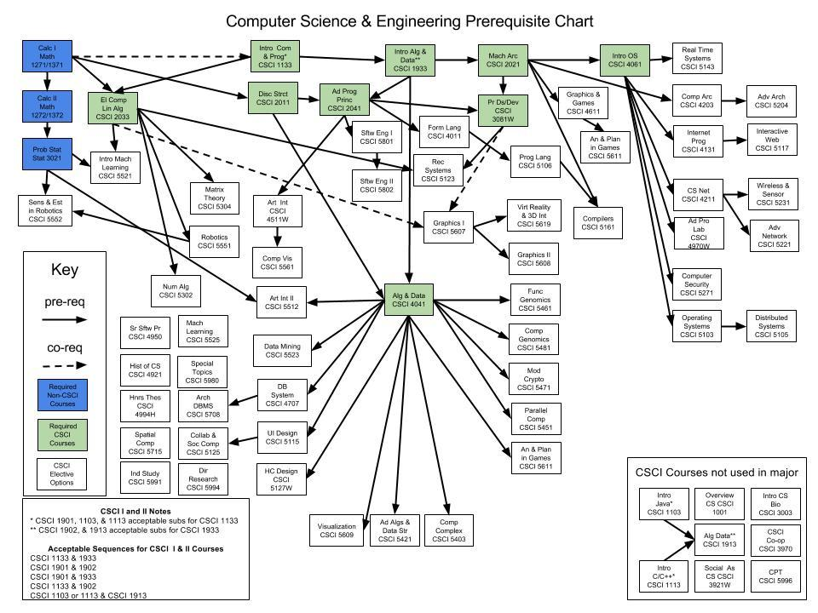
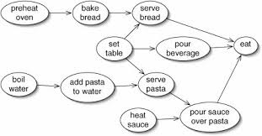
Topological Sort
A topological sort is an ordering of vertices such that if there is an edge from v_{i} to v_{j}, then v_{j} comes after v_{i}
Notes:
In the last lecture we covered BFS and DFS and today we will continue with some applications of these traversals in common problem.

Slide 49
Topological Sort
A simple algorithm to find a topological ordering is first to find any vertex with no incoming edges.
We can then print this vertex, and remove it, along with its edges, from the graph.
Then we apply this same strategy to the rest of the graph.
0
5
1
4
2
3
6
7
Notes:
In the last lecture we covered BFS and DFS and today we will continue with some applications of these traversals in common problem.

Slide 50
Topological Sort
A simple algorithm to find a topological ordering is first to find any vertex with no incoming edges.
We can then print this vertex, and remove it, along with its edges, from the graph.
Then we apply this same strategy to the rest of the graph.
0
5
1
4
2
3
6
7
V0 = {0, 5}
Sort Order = {}
Notes:
In the last lecture we covered BFS and DFS and today we will continue with some applications of these traversals in common problem.

Slide 51
Topological Sort
A simple algorithm to find a topological ordering is first to find any vertex with no incoming edges.
We can then print this vertex, and remove it, along with its edges, from the graph.
Then we apply this same strategy to the rest of the graph.
5
1
4
2
3
6
7
V0 = {5, 1}
Sort Order = {0}
Notes:
In the last lecture we covered BFS and DFS and today we will continue with some applications of these traversals in common problem.

Slide 52
Topological Sort
A simple algorithm to find a topological ordering is first to find any vertex with no incoming edges.
We can then print this vertex, and remove it, along with its edges, from the graph.
Then we apply this same strategy to the rest of the graph.
1
4
2
3
6
7
V0 = {1, 4}
Sort Order = {0, 5}
Notes:
In the last lecture we covered BFS and DFS and today we will continue with some applications of these traversals in common problem.

Slide 53
Topological Sort
A simple algorithm to find a topological ordering is first to find any vertex with no incoming edges.
We can then print this vertex, and remove it, along with its edges, from the graph.
Then we apply this same strategy to the rest of the graph.
4
2
3
6
7
V0 = {4, 7}
Sort Order = {0, 5, 1}
Notes:
In the last lecture we covered BFS and DFS and today we will continue with some applications of these traversals in common problem.

Slide 54
Topological Sort
A simple algorithm to find a topological ordering is first to find any vertex with no incoming edges.
We can then print this vertex, and remove it, along with its edges, from the graph.
Then we apply this same strategy to the rest of the graph.
4
2
3
6
7
V0 = {4, 7}
Sort Order = {0, 5, 1}
Notes:
In the last lecture we covered BFS and DFS and today we will continue with some applications of these traversals in common problem.

Slide 55
Topological Sort
A simple algorithm to find a topological ordering is first to find any vertex with no incoming edges.
We can then print this vertex, and remove it, along with its edges, from the graph.
Then we apply this same strategy to the rest of the graph.
2
3
6
7
V0 = {7, 2, 3}
Sort Order = {0, 5, 1, 4}
Notes:
In the last lecture we covered BFS and DFS and today we will continue with some applications of these traversals in common problem.

Slide 56
Topological Sort
A simple algorithm to find a topological ordering is first to find any vertex with no incoming edges.
We can then print this vertex, and remove it, along with its edges, from the graph.
Then we apply this same strategy to the rest of the graph.
2
3
6
V0 = {2, 3}
Sort Order = {0, 5, 1, 4, 7}
Notes:
In the last lecture we covered BFS and DFS and today we will continue with some applications of these traversals in common problem.

Slide 57
Topological Sort
A simple algorithm to find a topological ordering is first to find any vertex with no incoming edges.
We can then print this vertex, and remove it, along with its edges, from the graph.
Then we apply this same strategy to the rest of the graph.
3
6
V0 = {3, 6}
Sort Order = {0, 5, 1, 4, 7, 2 }
Notes:
In the last lecture we covered BFS and DFS and today we will continue with some applications of these traversals in common problem.

Slide 58
Topological Sort
A simple algorithm to find a topological ordering is first to find any vertex with no incoming edges.
We can then print this vertex, and remove it, along with its edges, from the graph.
Then we apply this same strategy to the rest of the graph.
6
V0 = {6}
Sort Order = {0, 5, 1, 4, 7, 2, 3 }
Notes:
In the last lecture we covered BFS and DFS and today we will continue with some applications of these traversals in common problem.

Slide 59
Topological Sort
A simple algorithm to find a topological ordering is first to find any vertex with no incoming edges.
We can then print this vertex, and remove it, along with its edges, from the graph.
Then we apply this same strategy to the rest of the graph.
V0 = {}
Sort Order = {0, 5, 1, 4, 7, 2, 3, 6}
Notes:
In the last lecture we covered BFS and DFS and today we will continue with some applications of these traversals in common problem.

Slide 60
Topological Sort Pseudocode
void Graph::topsort( )
{
Queue<Vertex> q;
int counter = 0;
q.makeEmpty( );
for each Vertex v
if( v.indegree == 0 )
q.enqueue( v );
while( !q.isEmpty( ) )
{
Vertex v = q.dequeue( );
v.topNum = ++counter; // Assign next number
for each Vertex w adjacent to v
if( --w.indegree == 0 )
q.enqueue( w );
}
if( counter != NUM_VERTICES )
throw CycleFoundException{ };
}
Notes:
In the last lecture we covered BFS and DFS and today we will continue with some applications of these traversals in common problem.

Slide 61
Questions
Notes:
In an undirected graph a cycle must contain at least three distinct vertices

